Slide 1


Optimizing Cryptographic Technique using Metaheuristic based Class Topper Optimization Algorithm
Rambilas Ganguly (BWU/BTD/21/084)
Arya Sundar Das (BWU/BTD/21/095)
Yubraj Shaw (BWU/BTD/21/098)
Aliva Mandal (BWU/BTD/21/106)
Mentor:- Dr. Debasis Acharya
BCSE-DS, 7B
PCC-CSD 783

Slide 2
Acknowledgement:-
We are pleased to express our gratitude and regards towards our Project Guide Dr. Debasis Acharya,
Assistant Professor, Department of Computer Science and Engineering-CS & DS, Brainware University, without his valuable guidance, inspiration and attention towards us, pursuing our project would have been impossible.
Last but not the least, we express our regards towards our friends and family for bearing with us and for being a source of constant motivation during the entire term of the work.

Slide 3

Objective:-
The objective of this study is to optimize cryptographic techniques by employing the Metaheuristic-based Class Topper Optimization (CTO) algorithm. CTO leverages a hierarchical learning framework to improve key aspects of cryptographic processes, such as key generation, encryption, and decryption. By iteratively learning from the best-performing candidates (class toppers), the algorithm aims to enhance the efficiency, security, and adaptability of cryptographic methods. This approach seeks to reduce computational complexity, improve resource utilization, and ensure robust protection against evolving threats, ultimately advancing the performance and reliability of cryptographic systems.

Slide 4
Agenda
Traditional Cryptography
CTO algorithm
&
Flowchart
CTO Algorithm effect
Advantage Disadvantages
&
Applications
Conclusion

Slide 5

Introduction
Importance in Modern Society
Cryptography underpins secure communication, online transactions, data storage, and identity management, securing our digital lives in a rapidly evolving technological landscape.
Cryptography Fundamentals
Cryptography involves transforming data into an unreadable format, ensuring confidentiality, integrity, and authentication. It plays a critical role in safeguarding sensitive information in various domains.

Slide 6
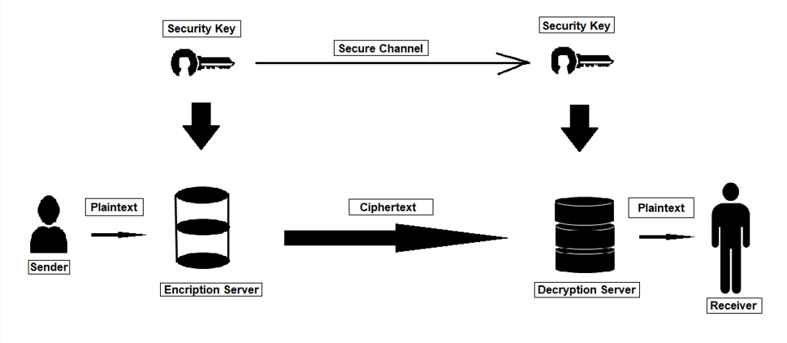
Overview of Traditional Cryptography

Slide 7

Need of Cryptographic Technique Optimization
Computational Complexity
Security-Efficiency
Balancing robust security measures with efficient performance is a crucial challenge. Enhancing security can lead to increased computational overhead, requiring careful optimization.
Optimizing cryptographic techniques often involves navigating computationally intensive tasks, demanding efficient algorithms and optimization strategies.
Evolving Threat Landscape
Cryptographic techniques must adapt to the ever-changing threat landscape. The emergence of new attack methods necessitates continuous optimization and improvement.

Slide 8

Class Topper Optimization Algorithm (CTOA)
Based on the concept of competitive learning and student ranking, CTOA simulates the process of students striving for academic excellence.
1
Individuals in the population represent students, with their fitness values reflecting their academic performance.
2
The algorithm employs learning and competition phases to guide the population towards improved solutions.
3

Slide 9
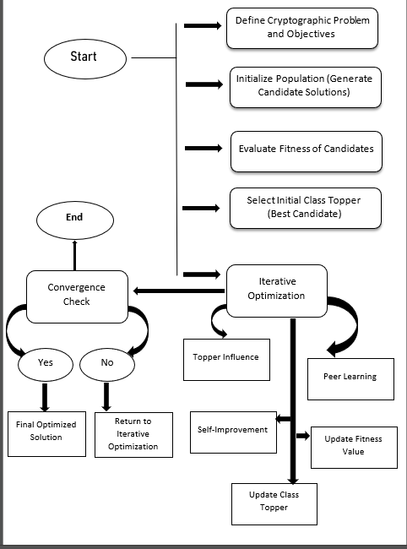
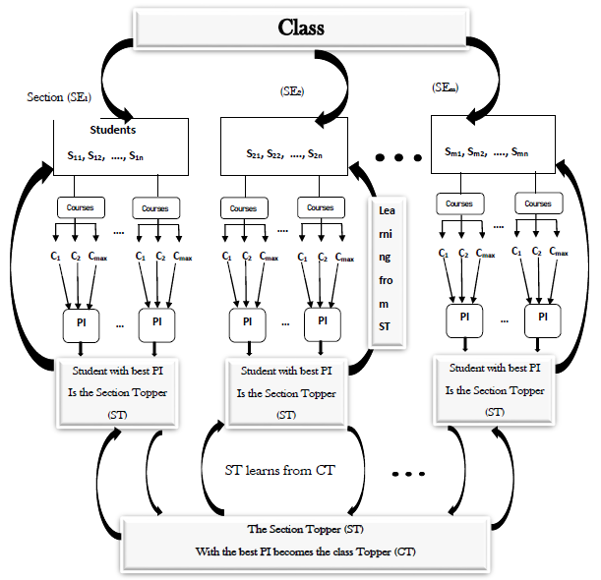

Slide 10
CTO algorithm Effects:-
Benchmarking
1
CTOA was evaluated on various benchmark cryptographic optimization problems, demonstrating significant performance gains.
Metrics
2
The algorithm's performance was measured using metrics such as security strength, computational time, and convergence speed.
Results
3
The experimental results confirmed CTOA's effectiveness in optimizing cryptographic techniques, leading to improved security and efficiency.

Slide 11


Practical Applications and Use Cases:-
Secure Communication
Financial Transactions
CTOA can optimize encryption algorithms, strengthening secure communication channels and protecting sensitive data.
The algorithm can enhance security protocols for online financial transactions, safeguarding user funds and preventing fraud.

Slide 12

Advantages of CTO Algorithm:-
Simple Concept:
Exploration and Exploitation:
CTO balances exploration and exploitation through its learning and competition mechanisms.
The core idea is easy to grasp, making it relatively straightforward to implement.
Versatility:
Applicable to a wide range of optimization tasks, from engineering design to financial modeling.

Slide 13

Disadvantages of CTO Algorithm:-
Potential Premature Convergence:
Sensitivity to Parameters:
The performance of CTO can be sensitive to the choice of parameters, such as the learning rate and the number of students.
In some cases, the algorithm might converge prematurely to a suboptimal solution, especially in highly multimodal problems.
Limited Theoretical Foundation:
Compared to some other metaheuristics, a strong theoretical foundation for CTO's convergence properties is still under development.

Slide 14

Conclusion
The research demonstrates the potential of CTO Algorithm in optimizing cryptographic techniques, contributing to improved security and efficiency. Future research will explore applying CTO Algorithm to more sophisticated cryptographic challenges, further advancing the field of technology.

Slide 15

References
[1] Das, P., Das, D. K., & Dey, S. (2018). A new class topper optimization algorithm with an application to data clustering. IEEE Transactions on Emerging Topics in Computing, 8(4), 948-959.
[2] Srivastava, A., & Das, D. K. (2020). A new aggrandized class topper optimization algorithm to solve economic load dispatch problem in a power system. IEEE Transactions on Cybernetics, 52(6), 4187-4197.G. O. Young, &quot; Synthetic structure of industrial plastics,& quot; in Plastics, 2nd ed., vol. 3, J.Peters, Ed. New York: McGraw-Hill, 1964, pp. 15- 64.
[3] Amponsah, A. A., Han, F., Ling, Q. H., & Kudjo, P. K. (2021). An enhanced class topper algorithm based on particle swarm optimizer for global optimization. Applied Intelligence, 51, 1022-1040.;s atmosphere,&quot; Aerospace Corp., Los Angeles, CA, Tech. Rep. TR- 0200 (4230-46)-3, Nov.1968.
[4] Sundararaj, D. E., & Usha, G. (2024). Implementation of optimisation adopted adaptive elliptical curve cryptography with additive homomorphic encryption-based privacy preservation in mobile crowd sensing environment. International Journal of Sensor Networks, 46(3), 127-141.

Slide 16






